Slide 1
Simple Mail Transfer Protocol
Notes:
http://www.spamfilterreview.com/spam-statistics.html, stats about spam

Slide 2
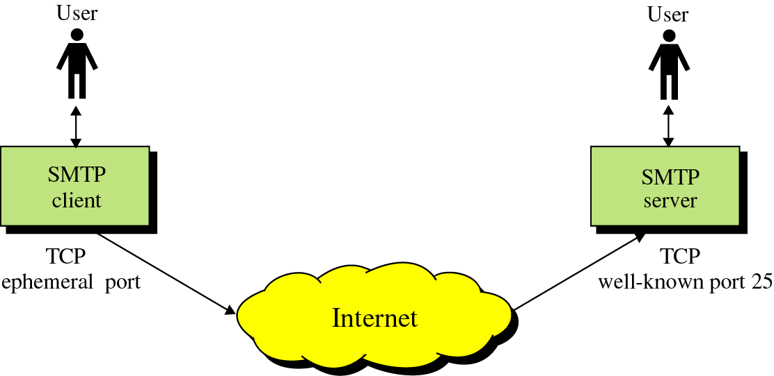
SMTP
Originated in 1982 (rfc0821, Jon Postel)
Goal: To transfer mail reliably and efficiently

Slide 3
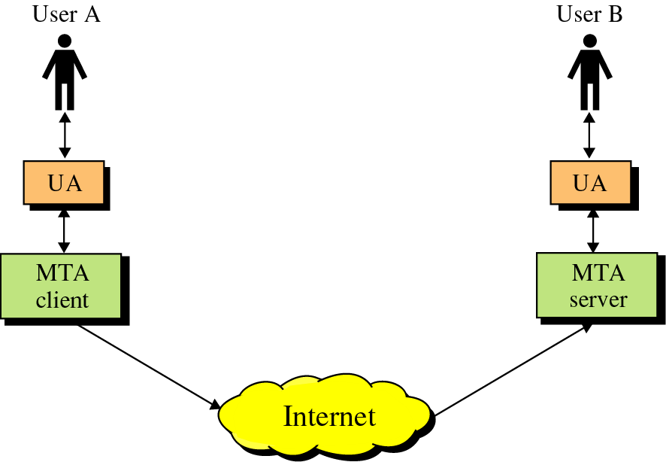
SMTP
SMTP clients and servers have two main components
  User Agents – Prepares the message, encloses it in an envelope. (Eudora for example)
  Mail Transfer Agent – Transfers the mail across the internet
User Agent
Mail Transfer Agents

Slide 4
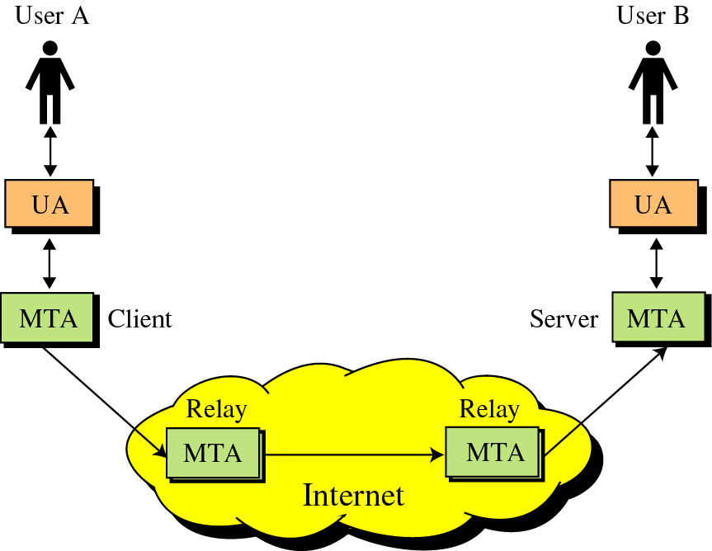
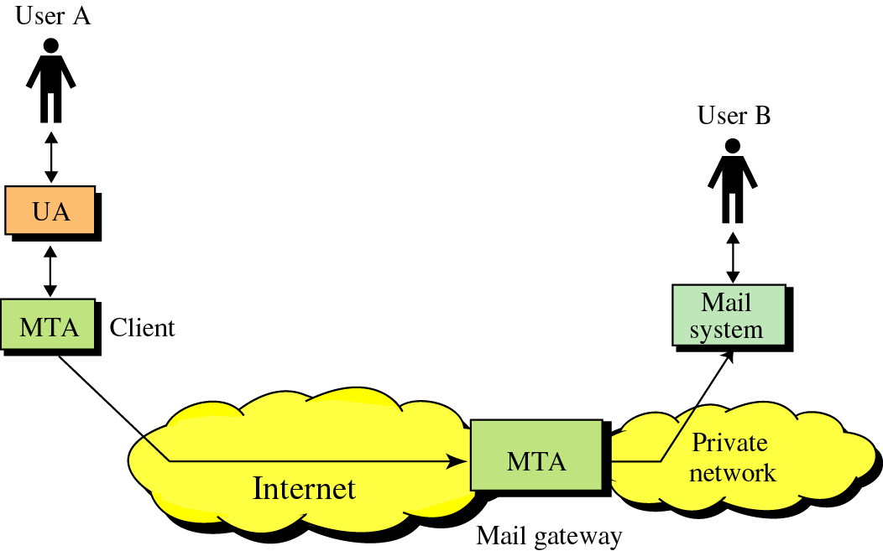
SMTP
SMTP also allows the use of Relays allowing other MTAs to relay the mail
Mail Gateways are used to relay mail prepared by a protocol other then SMTP and convert it to SMTP

Slide 5
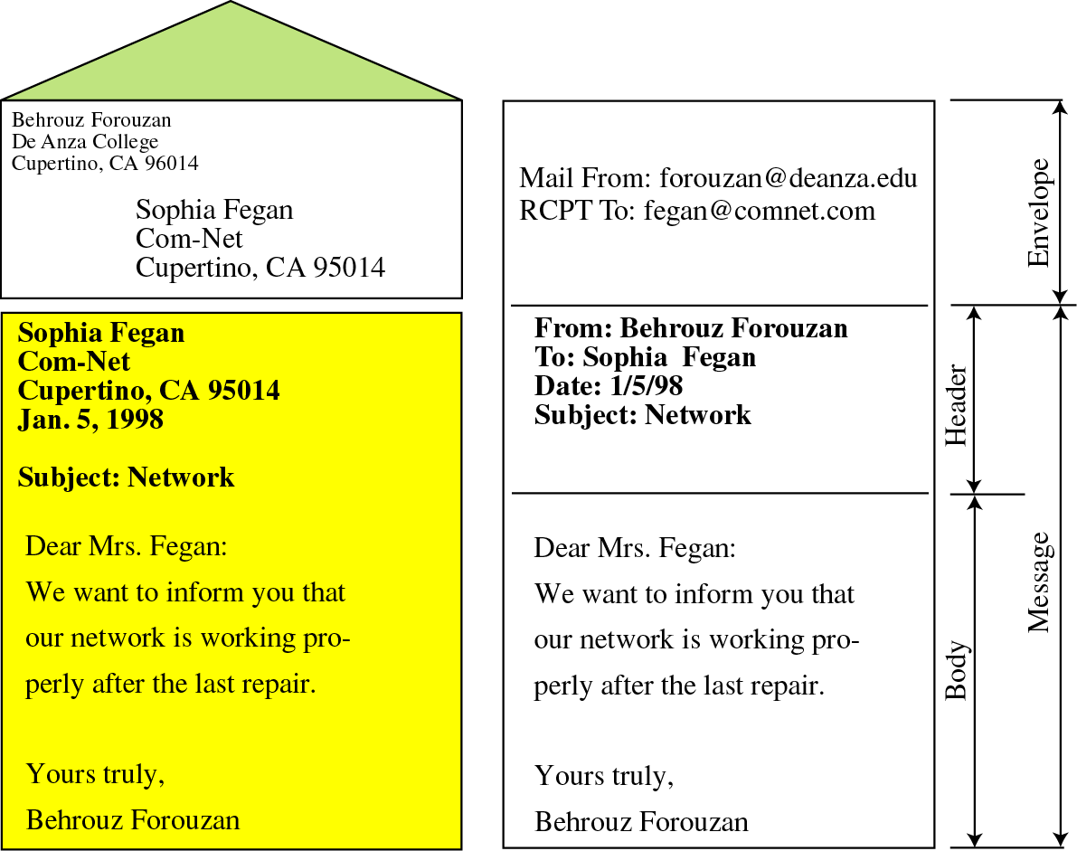
What is Mail?
Mail is a text file
Envelope –
  sender address
  receiver address
  other information
Message –
  Mail Header – defines the sender, the receiver, the subject of the message, and some other information
  Mail Body – Contains the actual information in the message

Slide 6
How SMTP works (A-PDU’s)
The Essentials
Keyword | Arguments
HELO | Sender’s Host Domain Name
MAIL FROM: | Email Address of sender
RCPT TO: | Email of Intended recipient
DATA | Body of the message
QUIT

Slide 7
How SMTP works (A-PDU’s)
The Extras
Keyword | Arguments
RSET
VRFY | Name to be verified
NOOP
TURN
EXPN | Mailing list to expand
HELP | Command Name

Slide 8
Status Codes
The Server responds with a 3 digit code that may be followed by text info
  2## - Success
  3## - Command can be accepted with more information
  4## - Command was rejected, but error condition is temporary
  5## - Command rejected, Bad User!

Slide 9
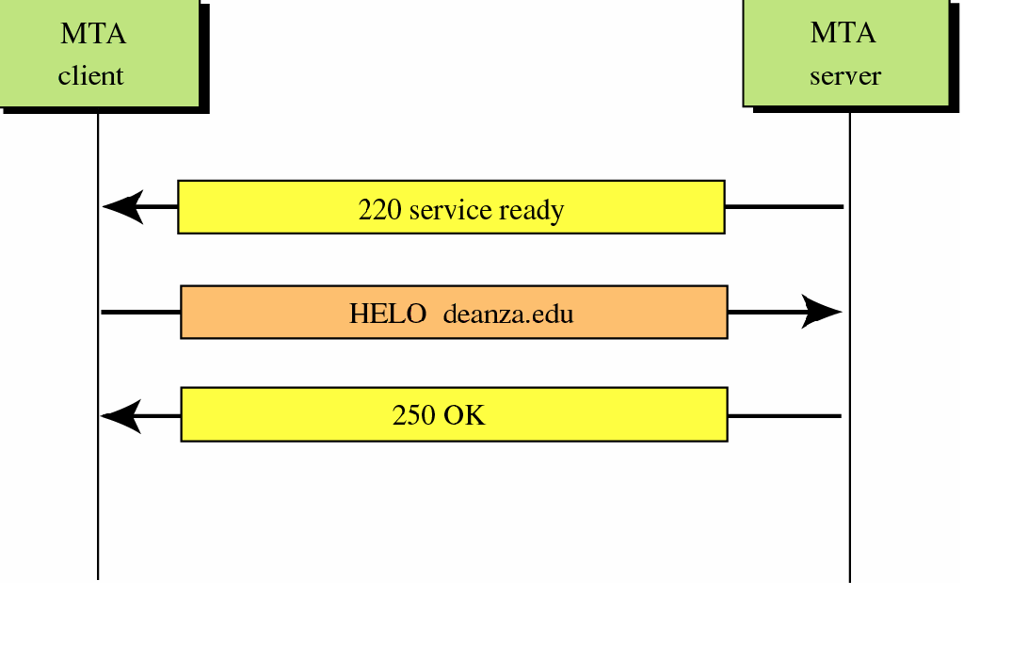
Connection Establishment
TCP Connection Establishment

Slide 10
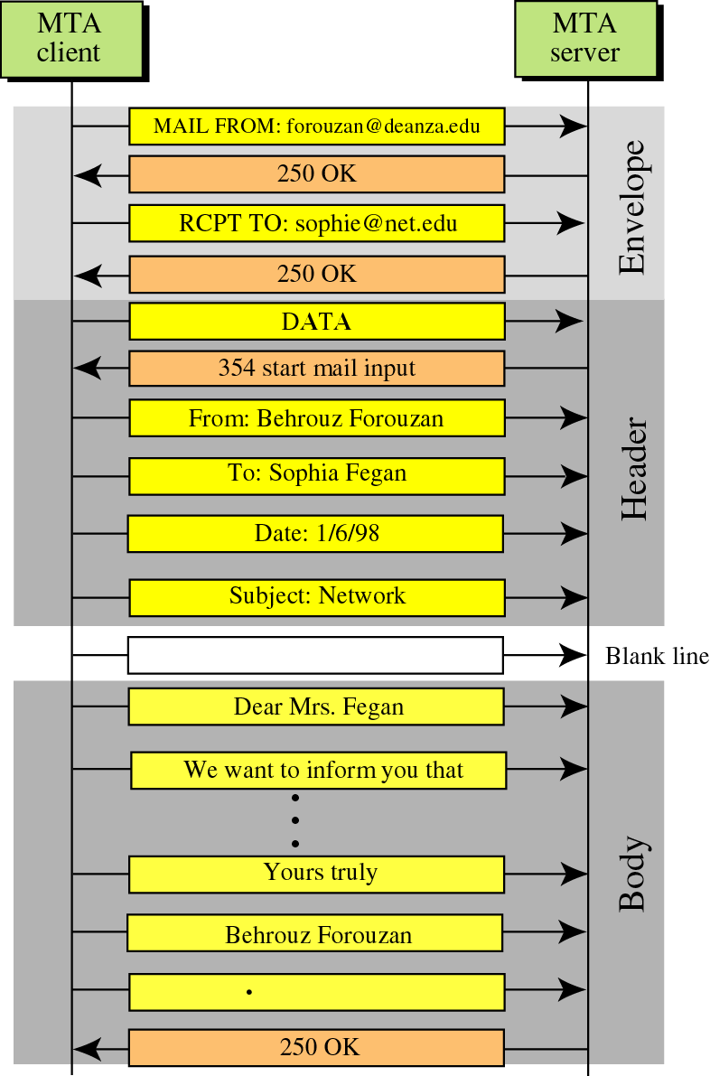
Message Progress

Slide 11
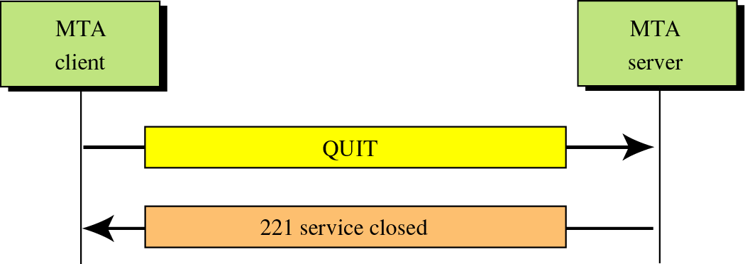
Connection Termination
TCP Connection Termination

Slide 12
E-mails can be forged…..
HELO stimpy.eecis.udel.edu
MAIL FROM: carberry@cis.udel.edu
RCPT TO: amer@cis.udel.edu
DATA
From: Dr. Sandra Carberry
To: Dr. Paul Amer
Subject: CISC856
Dr. Amer,
By department decree all students in your CISC856 TCP/IP class are hereby to be given automatic A’s.
Thank you,
Dr. M. Sandra Carberry
.
QUIT

Slide 13
Mail Access Protocols
The MTAs place the email in the user’s mailbox
The Mail Access Protocols are used by the users to retrieve the email from the mailbox
  POP3
  IMAP4

Slide 14
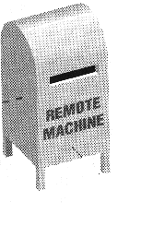
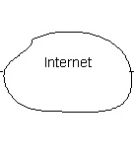
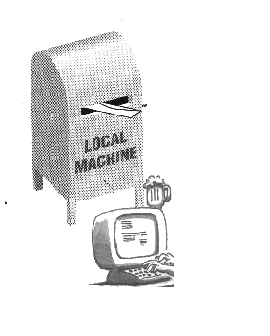

POP vs. IMAP
POP3:
All Messages
Whole message
IMAP:
Dr.Amer
Friends
….
headers

Slide 15
Post Office Protocol v3
Simple
Allows the user to obtain a list of their Emails
Users can retrieve their emails
Users can either delete or keep the email on their system
Minimizes server resources
Notes:
http://www.washington.edu/computing/windows/issue13/imap_pop.html

Slide 16
Internet Mail Access Protocol v4
Has more features then POP3
User can check the email header before downloading
Emails can be accessed from any location
Can search the email for a specific string of characters before downloading
User can download parts of an email
User can create, delete, or rename mailboxes on a server

